Slide 1
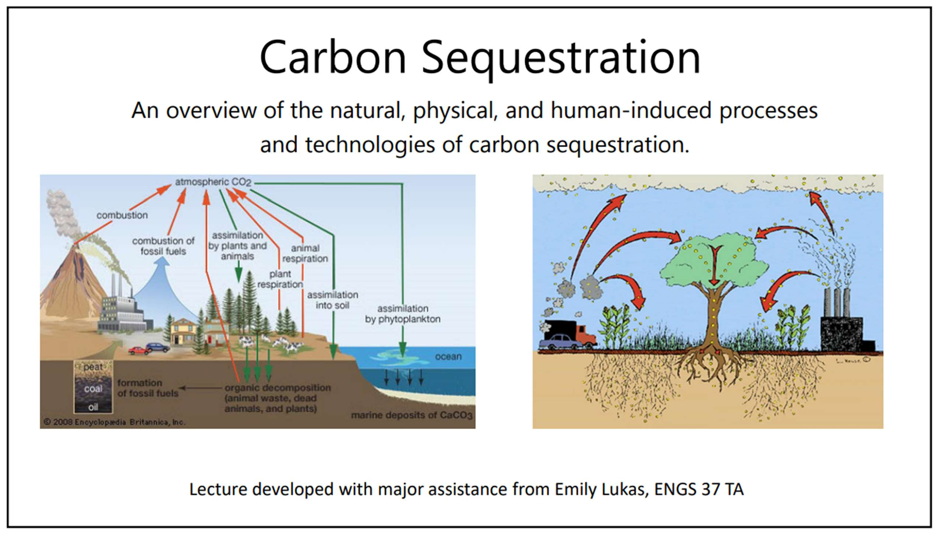


Slide 2

Members of team
V Ritesh
Bandi Praveen
Sania Benazir
Janagani Ganesh
- 9921005274
- 99210042224
- 99210042228
- 99210042224

Slide 3
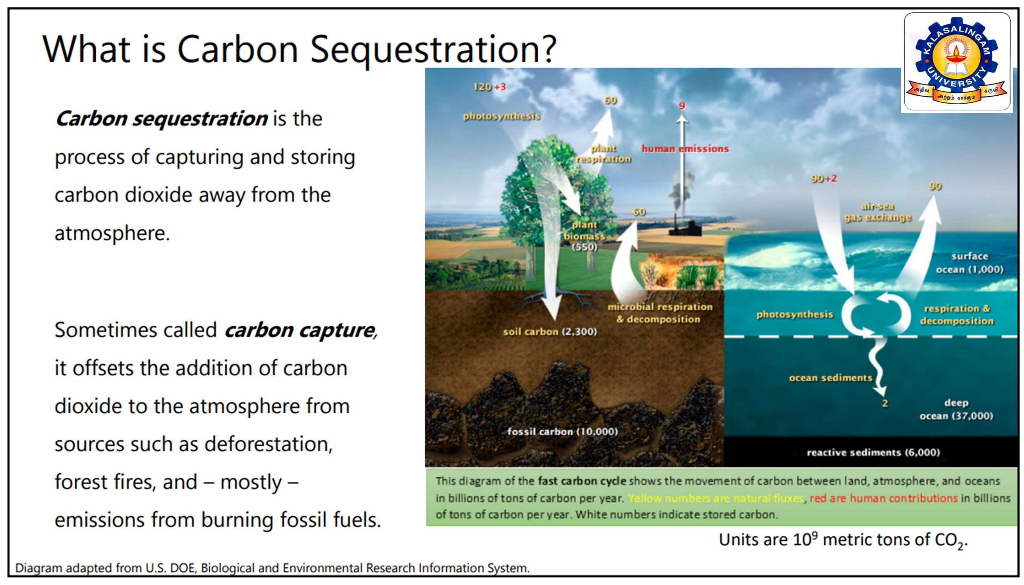

Slide 4

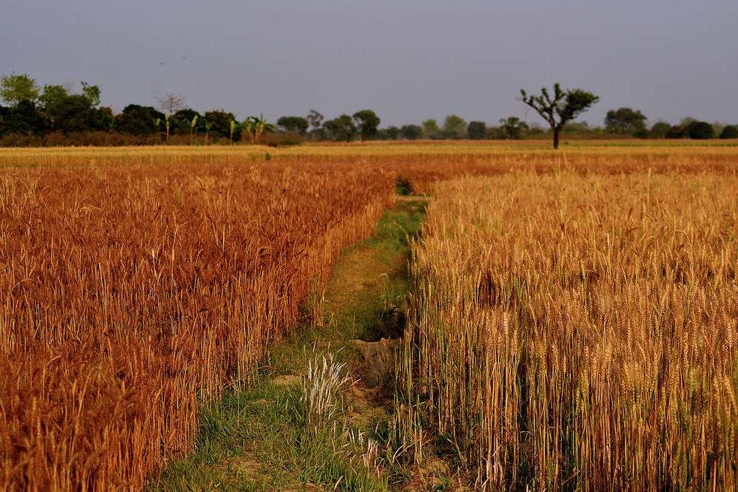
Why carbon is bad for agriculture?
Under elevated CO₂ most plant species show
Higher rates of photosynthesis
Increased growth
Decreased water use and
Lowered tissue concentrations of nitrogen and protein.
Rising CO₂ over the next century is likely to
affect both agricultural production and food quality.
The study and the picture is adopted from : https://www.nasa.gov/feature/goddard/2016/nasa-study-rising-carbon-dioxide-levels-will-help-and-hurt-crops
4

Slide 5
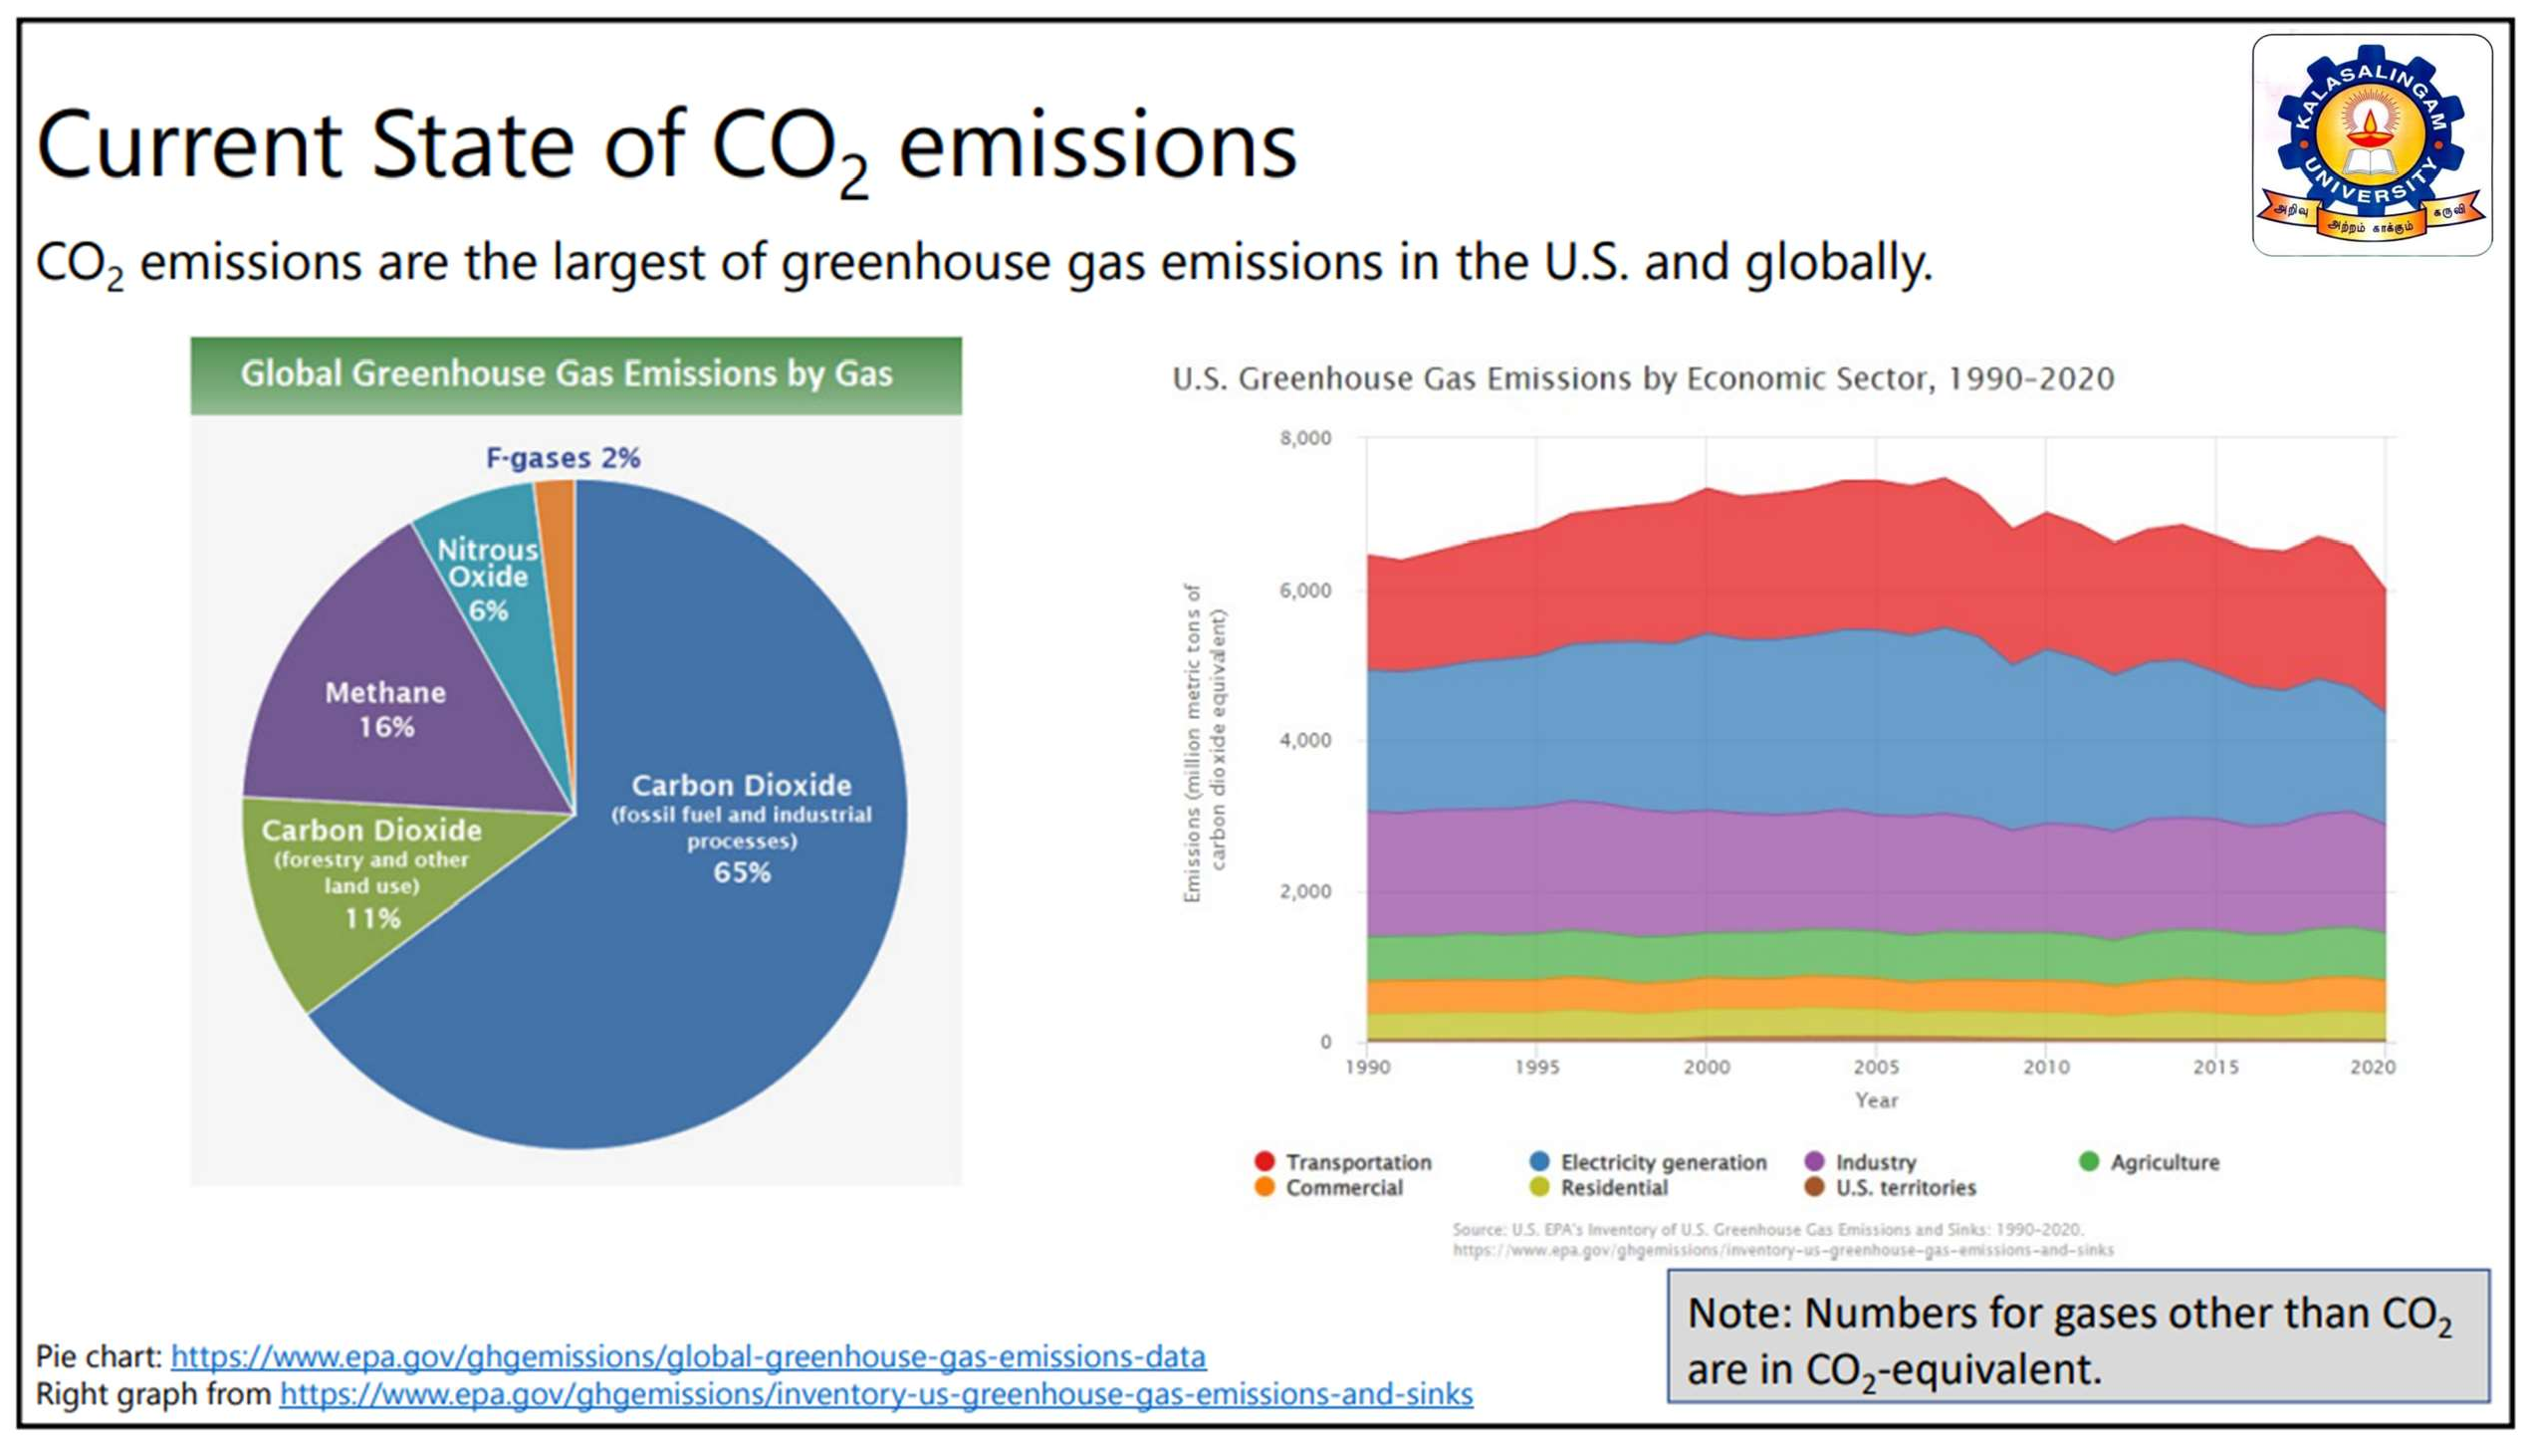

Slide 6
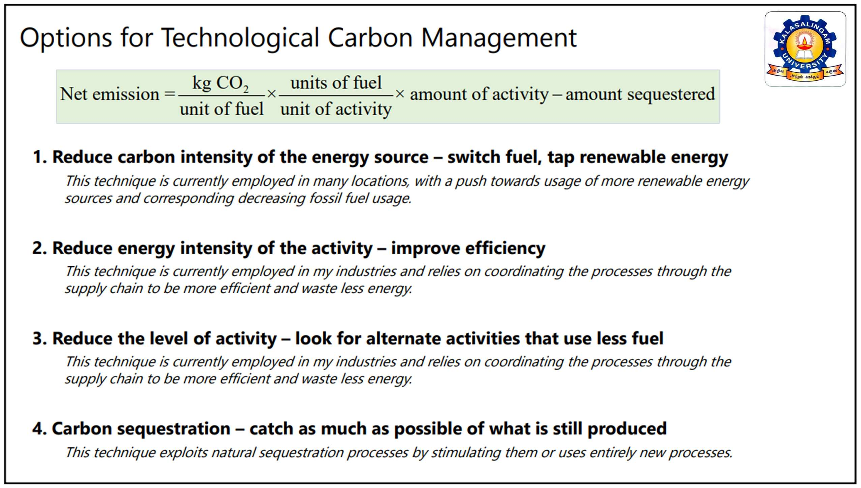

Slide 7
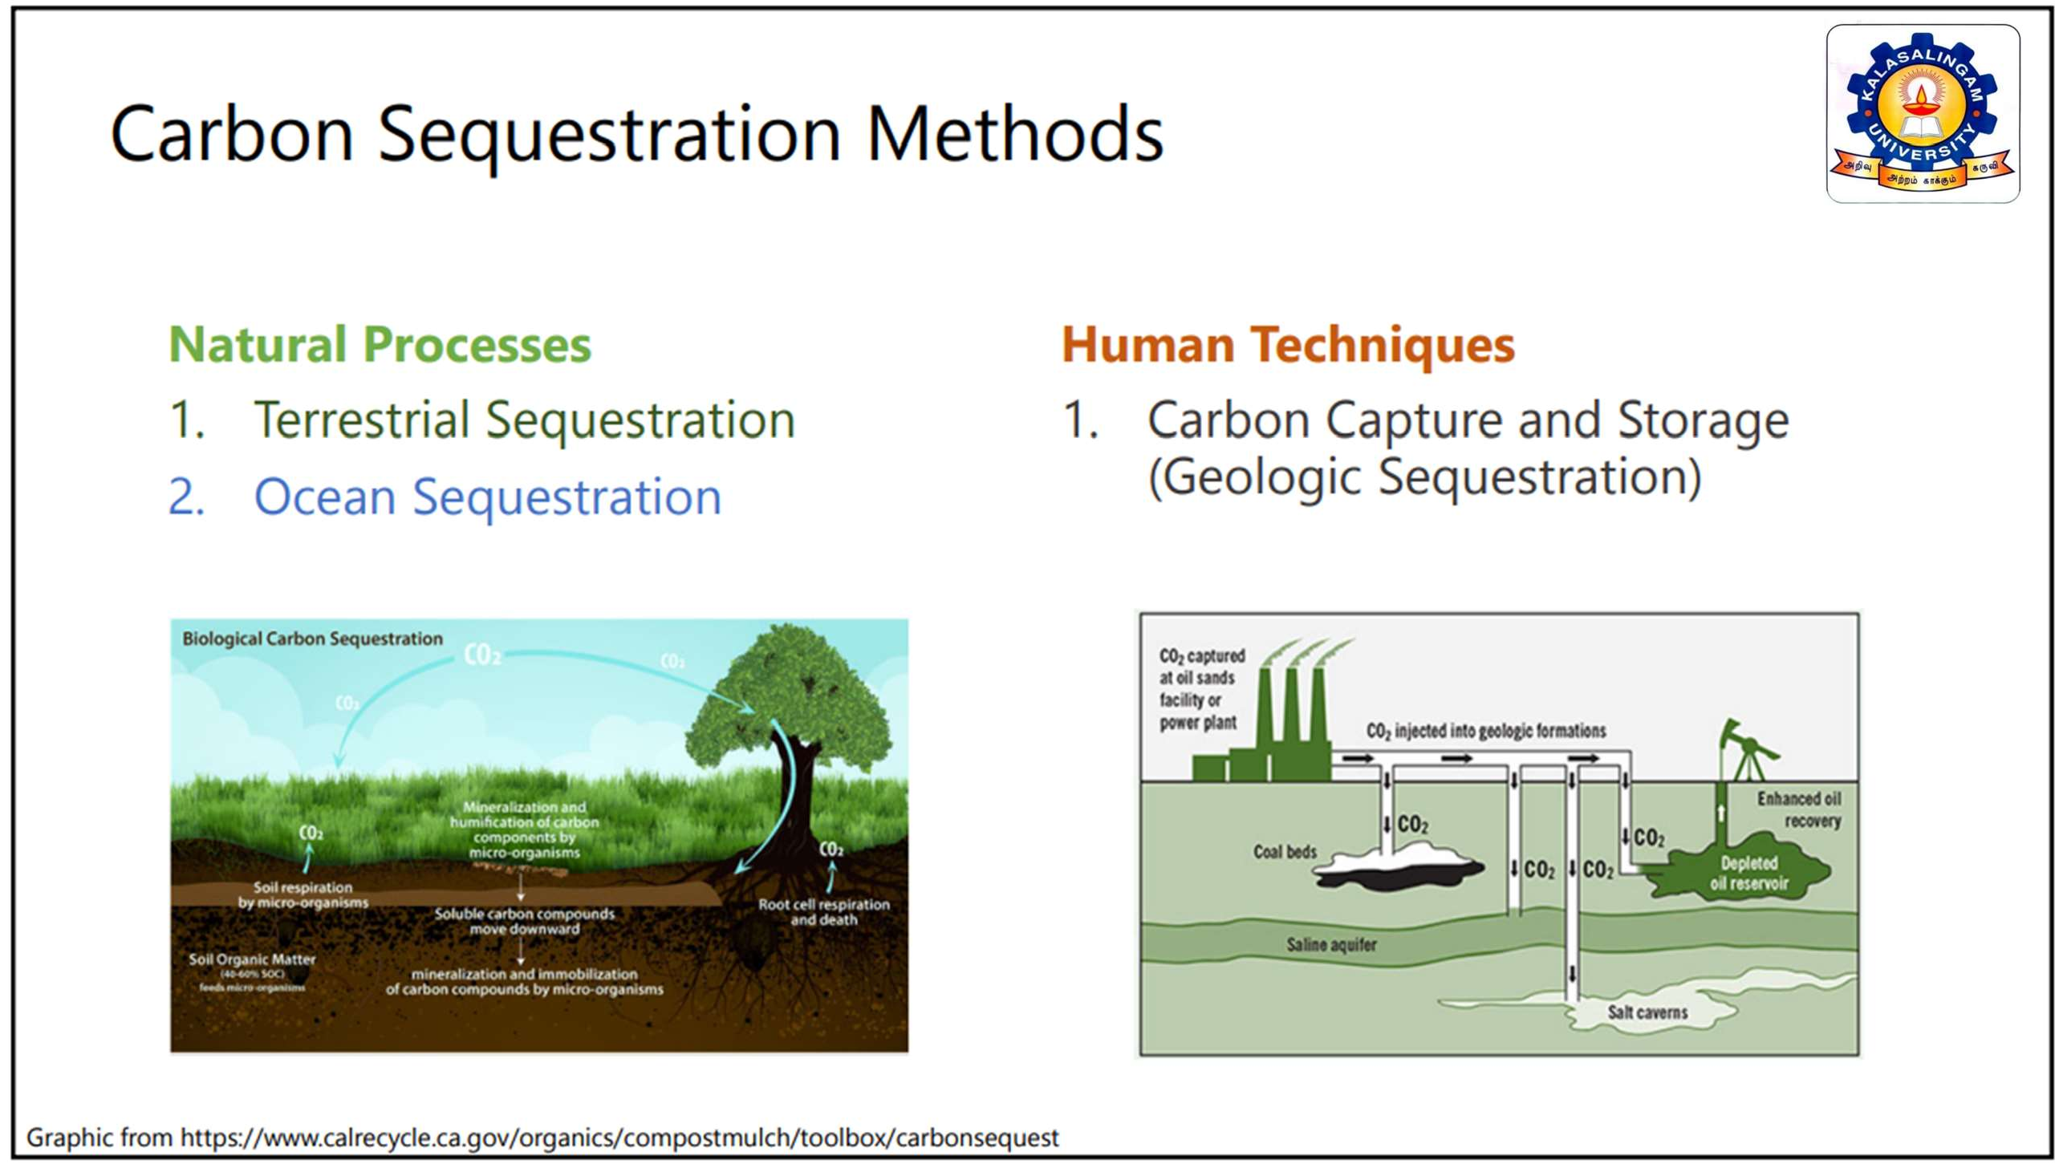

Slide 8

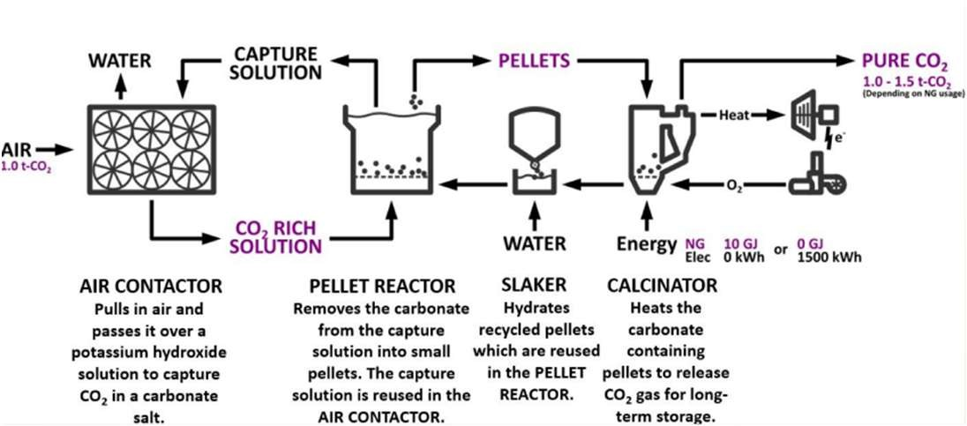
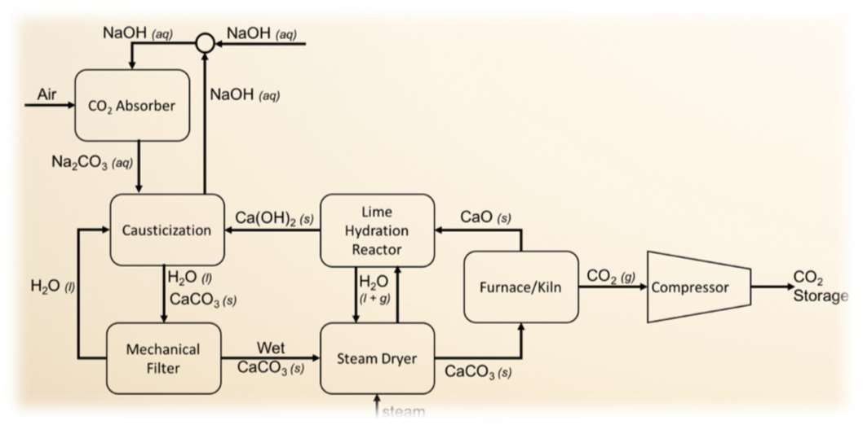
Direct Air Capture(DAC)
The direct air capture technique is how the carbon engineering firm concept operates.
The commercialisation of Direct Air Capture (DAC) technology, which removes carbon dioxide (CO2) directly from the atmosphere, is the main goal of the Canadian clean energy firm Carbon Engineering Ltd.
By employing renewable energy sources and a process the company calls "Air to Fuels," this absorbed CO2 may either be stored underground or transformed into carbon-neutral fuel.
Let’s look at the successive phases in Direct Air Capture(DAC)
Sources and diagram is from : https://nap.nationalacademies.org/read/1911/chapter/8#116
8

Slide 9

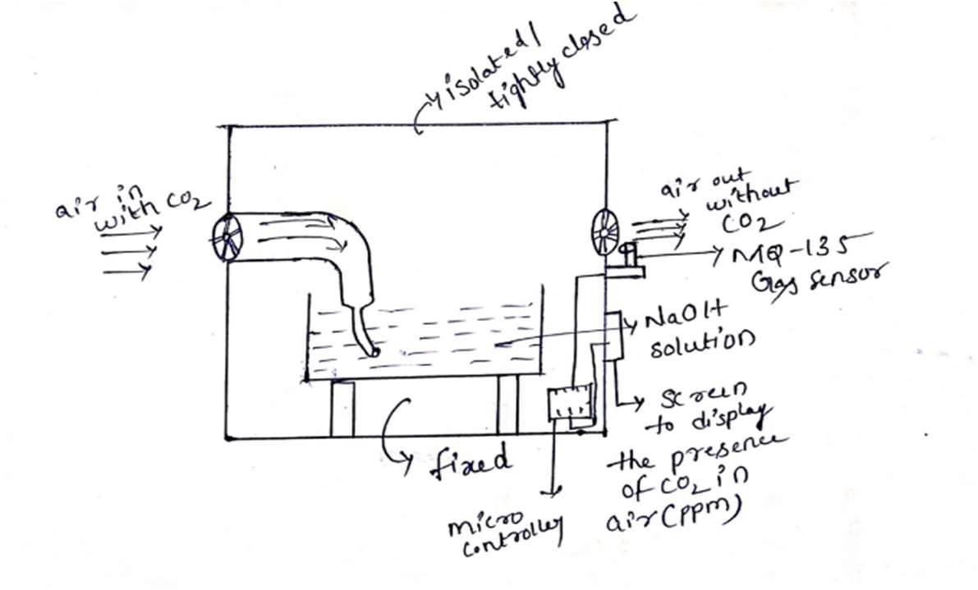
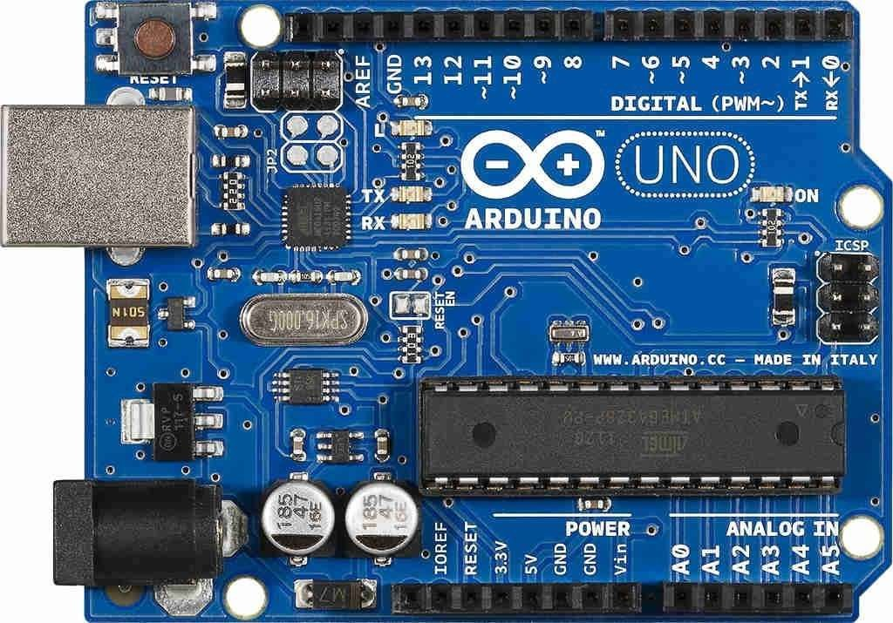
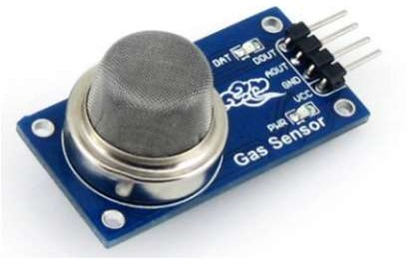
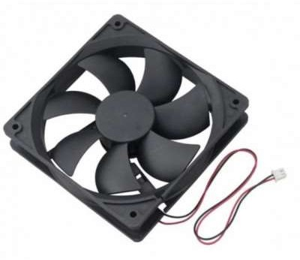
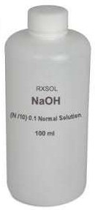
PRIMARY COMPONENTS REQUIRED FOR OUR PROTOTYPE
Arduino UNO R3
MQ135 Gas sensor
Exhaust Fans
NaOH Solution/Pellets
PRIMARY PROCESS GOING IN OUR PROTOTYPE
2NaOH + CO2 -------> Na2CO3 + H2O
Sodium Hydroxide (NaOH) reacts with Carbon Dioxide (CO2) to produce Sodium Carbonate (Na2CO3) and Water (H2O).Sodium Carbonate is typically a Washing Soda.
Structure of our prototype
9

Slide 10
Connections
1. MQ135 Gas Sensor:
- Vcc to 5V on Arduino
- GND to GND on Arduino
- A0 to A0 on Arduino
2. LCD:
- VSS to GND on Arduino
- VDD to 5V on Arduino
- VO (contrast) to the middle pin of the potentiometer
- RS to D12 on Arduino
- RW to GND on Arduino
- E to D11 on Arduino
- D4 to D5 on Arduino
- D5 to D4 on Arduino
- D6 to D3 on Arduino
- D7 to D2 on Arduino
- A to 5V on Arduino
- K to GND on Arduino
3. Exhaust Fan:
- Connect one terminal to a suitable power source (e.g., external 12V supply).
- Connect the other terminal to the collector of an NPN transistor (e.g., 2N2222).
- Connect the emitter of the transistor to GND on Arduino.
- Connect the base of the transistor to D8 on Arduino.
4. Air Pump Motor:
- Connect one terminal to a suitable power source (e.g., external 12V supply).
- Connect the other terminal to the collector of another NPN transistor.
- Connect the emitter of this transistor to GND on Arduino.
- Connect the base of this transistor to D9 on Arduino.
5. Potentiometer (for LCD contrast):
- VCC to 5V on Arduino
- GND to GND on Arduino
- Signal (middle pin) to LCD VO (contrast)
6. pH Sensor (for KOH saturation):
- VCC to 5V on Arduino
- GND to GND on Arduino
- Analog output to A1 on Arduino
10

Slide 11
Program Code
#include <LiquidCrystal.h>
#include "MQ135.h"
const int ANALOG_PIN = A0; // MQ135 analog pin
const int FAN_PIN = 8; // Exhaust fan control pin
const int PUMP_PIN = 9; // Air pump motor control pin
const int PH_SENSOR_PIN = A1; // pH sensor analog pin
MQ135 gasSensor = MQ135(ANALOG_PIN);
LiquidCrystal lcd(12, 11, 5, 4, 3, 2);
void setup() {
Serial.begin(9600);
lcd.begin(16, 2);
pinMode(FAN_PIN, OUTPUT);
pinMode(PUMP_PIN, OUTPUT);
pinMode(PH_SENSOR_PIN, INPUT);
}
void loop() {
float ppm = gasSensor.getPPM();
int phValue = analogRead(PH_SENSOR_PIN);
lcd.clear();
lcd.setCursor(0, 0);
lcd.print("CO2 PPM LEVEL:");
lcd.setCursor(0, 1);
lcd.print(ppm * 10);
Serial.print("CO2 ppm value: ");
Serial.println(ppm);
lcd.setCursor(0, 2);
lcd.print("pH Value:");
lcd.setCursor(0, 3);
lcd.print(phValue);
// Adjust the pH and CO2 thresholds as needed
if (phValue > 10 && ppm > 350) {
// Turn on exhaust fan and air pump motor
digitalWrite(FAN_PIN, HIGH);
digitalWrite(PUMP_PIN, HIGH);
lcd.setCursor(0, 4);
lcd.print("KOH Saturated!");
} else {
// Turn off exhaust fan and air pump motor
digitalWrite(FAN_PIN, LOW);
digitalWrite(PUMP_PIN, LOW);
}
delay(1000);
}
10

Slide 12
CONCLUSION
Carbon sequestration is not a method to reduce or regulate the amount of carbon in the atmosphere.
The only way to transform the planet is to increase plant growth while reducing or halting deforestation.
We are all responsible for the strange climatic variations.
Let's at least start now to take responsibility for our environment and use the resources we have as needed.
10

Slide 13


11

